Slide 1

DESIGN AND ANALYSIS OF ALGORITHMS(24UAMPC204) Backtracking and Greedy approach Unit -II
Sanjivani University
School of Engineering and Technology
Department of AIML
By,
Prof. Chanda Pathak

Slide 2
Contents
General method
Applications
Knapsack problem
n-queen’s problem
Job sequencing with deadlines
Minimum cost spanning trees
Single source shortest path problem

Slide 3
Backtracking General Method
Backtracking is like trying different paths, and when you hit a dead end, you backtrack to the last choice and try a different route. It is a problem-solving algorithmic technique that involves finding a solution incrementally by trying different options and undoing them if they lead to a dead end.
Define the problem: Identify the problem you want to solve and define the constraints that must be satisfied.
Choose a starting point: Select a starting point for the search, which is typically an empty or partial solution.
Explore the solution space: Recursively explore the solution space by adding one element at a time to the current solution.
Check constraints: After adding each element, check whether the current solution satisfies the constraints.
Backtrack: If the current solution does not satisfy the constraints, backtrack by removing the last element added and exploring alternative solutions.
Repeat: Repeat steps 3-5 until a solution is found or the solution space has been exhausted.
Notes:
Definition of Algorithm
An algorithm is:
A set of finite rules or instructions for calculations or problem-solving.
A procedure to solve a mathematical problem in a finite number of steps, often involving recursion.
Definition-An algorithm is a set of commands that must be followed for a computer to perform calculations or other problem-solving operations. According to its formal definition, an algorithm is a finite set of instructions carried out in a specific order to perform a particular task. It is not the entire program or code; it is simple logic to a problem represented as an informal description in the form of a flowchart or pseudocode.
Use of Algorithms
Algorithms are fundamental across various domains:
Computer Science: From sorting and searching to AI and ML tasks.
Mathematics: Solving equations, finding paths in graphs.
Operations Research: Optimization in logistics, transportation.
AI & Machine Learning: Tasks like image recognition and decision-making.
Data Science: Analyzing data, predictions in healthcare, finance, etc.
Need for Algorithms
Algorithms:
Solve complex problems efficiently.
Automate and optimize processes.
Enable tasks that are challenging or impossible manually.
Characteristics of an Algorithm
Clear and Unambiguous: Each step must be precise and meaningful.
Well-Defined Inputs & Outputs: Inputs and results should be clearly specified.
Finiteness: Must terminate after a finite number of steps.
Feasibility: Practical and executable with available resources.
Language Independence: Instructions work regardless of programming language.
Properties of an Algorithm
Finite termination.
At least one output.
Deterministic (consistent output for the same input).
Effective (each step performs meaningful work).
Types of Algorithms
Brute Force: Simplest and exhaustive approach.
Recursive: Problem-solving via repeated subproblem solutions.
Backtracking: Tracing back upon failure to find solutions.
Searching & Sorting: Locating or arranging data efficiently.
Hashing: Indexing data for faster retrieval.
Divide and Conquer: Splitting problems into smaller subproblems.
Greedy: Choosing the immediate optimal solution.
Dynamic Programming: Avoids recalculation by storing results of overlapping subproblems.
Randomized: Uses random numbers for unpredictable yet beneficial outcomes.
Advantages of Algorithms
Clear problem-solving steps.
Easier translation into code.
Breaks down problems into smaller, manageable parts.
Disadvantages of Algorithms
Time-consuming to write.
Challenging to represent complex logic.
Hard to show branching/loops effectively.

Slide 4
Applications
Constraint Satisfaction Problems
Sudoku: Backtracking is used to solve Sudoku puzzles by filling in numbers that satisfy the constraints.
Crosswords: Backtracking can be used to solve crossword puzzles by finding words that fit the given clues.
Graph Algorithms
Hamiltonian Cycle: Backtracking can be used to find a Hamiltonian cycle in a graph, which is a cycle that visits each vertex exactly once.
Traveling Salesman Problem: Backtracking can be used to solve the Traveling Salesman Problem, which involves finding the shortest possible tour that visits a set of cities and returns to the starting city.
Combinatorial Optimization
Knapsack Problem: Backtracking can be used to solve the Knapsack Problem, which involves finding the optimal subset of items to include in a knapsack of limited capacity.
Set Cover Problem: Backtracking can be used to solve the Set Cover Problem, which involves finding the smallest subset of sets that cover a given universe of elements.

Slide 5
Greedy Approach
A Greedy algorithm is an approach to solving a problem that selects the most appropriate option based on the current situation. This algorithm ignores the fact that the current best result may not bring about the overall optimal result. Even if the initial decision was incorrect, the algorithm never reverses it.
Steps for Solve a Greedy Algorithm
Step 1: In a given problem, find the best substructure or subproblem.
Step 2: Determine what the solution will include (e.g., largest sum, shortest path).
Step 3: Create an iterative process for going over all subproblems and creating an optimum solution.

Slide 6
Applications
It is used in finding the shortest path.
It is used to find the minimum spanning tree using the prim's algorithm or the Kruskal's algorithm.
It is used in a job sequencing with a deadline.
This algorithm is also used to solve the fractional knapsack problem.

Slide 7
Knapsack Problem
The Knapsack problem is an example of the combinational optimization problem. This problem is also commonly known as the “Rucksack Problem“.
The Knapsack Problem is a classic optimization problem in computer science and mathematics. Imagine you have a knapsack (a type of bag) with a fixed carrying capacity and you want to fill it with a selection of items, each having a specific weight and value. The goal is to maximize the total value of the items in the knapsack without exceeding its weight capacity.
Example : For the given set of items and the knapsack capacity of 20 kg, find the subset of the items to be added in the knapsack such that the profit is maximum.
Object | O1 | O2 | O3
Profit | 25 | 24 | 15
Weight | 18 | 15 | 10

Slide 8
Knapsack Problem
Greedy about profit:
Total Profit = 1*25+2/15*24+0*15
=28.2
Greedy about Weight:
Total Profit = 0*25+10/15*24+1*15 = 31
Object | O1 | O2 | O3
Profit | 25 | 24 | 15
Weight | 18 | 15 | 10
 | 1 | 2/15 | 0
Object | O1 | O2 | O3
Profit | 25 | 24 | 15
Weight | 18 | 15 | 10

Slide 9
Greedy by Profit/Weight:
Total Profit = 0*25+1*24+5/10*15
= 31.5
Time Complexity: O(N * logN)
Object | O1 | O2 | O3
Profit | 25 | 24 | 15
Weight | 18 | 15 | 10
Profit/Weight | 1.38 | 1.6 | 1.5

Slide 10
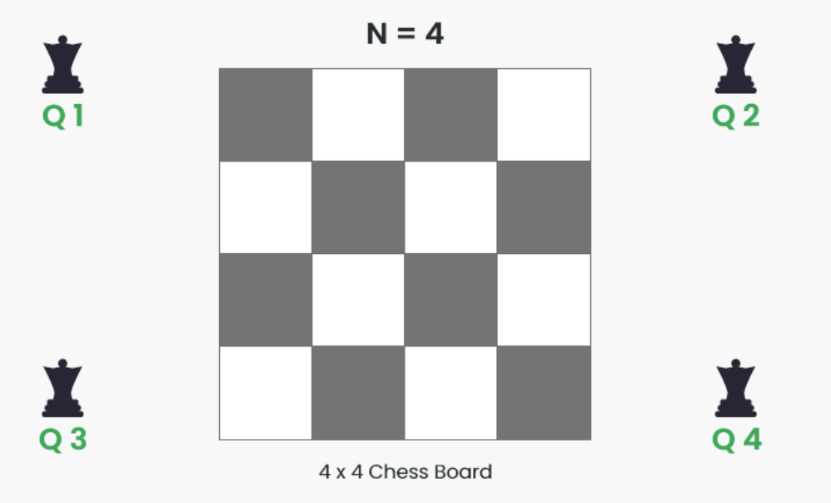
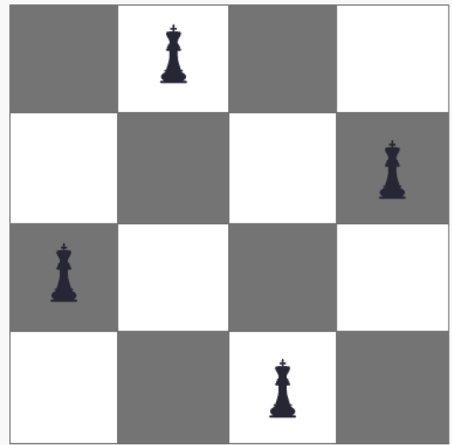
n-queen’s Problem
The N Queen is the problem of placing N chess queens on an N×N chessboard so that no two queens attack each other by being in the same row, column or diagonal.
For example, the following is a solution for the 4 Queen problem.

Slide 11
n-queen’s Problem
Step 1: Initialize the Board
Create an NxN matrix filled with zeros, representing the empty chessboard.
Step 2: Place Queens
Start from the first row and try to place a queen in each column.
For each column, check if the queen can be placed safely (i.e., no other queen attacks it).
If a safe position is found, place the queen and move to the next row.
If no safe position is found, backtrack to the previous row and try a different column.
Step 3: Check Safety
To check if a queen can be placed safely, verify that:
No other queen is in the same column.
No other queen is in the same diagonal (either upper-left to lower-right or upper-right to lower-left).
Notes:
// Java Program to solve the n-queens problem
import java.util.*;
class GfG {
// Function to check if it is safe to place
// the queen at board[row][col]
static boolean isSafe(int[][] mat,
int row, int col) {
int n = mat.length;
// Check this col on upper side
for (int i = 0; i < row; i++)
if (mat[i][col] == 1)
return false;
// Check upper diagonal on left side
for (int i = row - 1, j = col - 1;
i >= 0 && j >= 0; i--, j--)
if (mat[i][j] == 1)
return false;
// Check lower diagonal on left side
for (int i = row - 1, j = col + 1;
j < n && i >= 0; i--, j++)
if (mat[i][j] == 1)
return false;
return true;
}
static boolean placeQueens(int row, int[][] mat) {
int n = mat.length;
// base case: If all queens are placed
// then return true
if (row == n)
return true;
// Consider the row and try placing
// queen in all columns one by one
for (int i = 0; i < n; i++) {
// Check if the queen can be placed
if (isSafe(mat, row, i)) {
mat[row][i] = 1;
if (placeQueens(row + 1, mat))
return true;
mat[row][i] = 0;
}
}
return false;
}
// Function to find the solution
// to the N-Queens problem
static List<Integer> nQueen(int n) {
// Initialize the board
int[][] mat = new int[n][n];
// If the solution exists
if (placeQueens(0, mat)) {
// to store the columns of the queens
List<Integer> ans = new ArrayList<>();
for (int i = 0; i < n; i++) {
for (int j = 0; j < n; j++) {
if (mat[i][j] == 1) {
ans.add(j + 1);
}
}
}
return ans;
}
else
return Collections.singletonList(-1);
}
public static void main(String[] args) {
int n = 4;
List<Integer> ans = nQueen(n);
for (int i : ans) {
System.out.print(i + " ");
}
}
}

Slide 12
n-queen’s Problem
Step 4: Backtrack
If a queen cannot be placed safely in any column, backtrack to the previous row and try a different column.
If all columns have been tried and no safe position is found, backtrack to the previous row and try a different column.
Step 5: Solution Found
If all queens have been placed safely, a solution has been found.
Notes:
Key Characteristics:
Root Node: The root of the tree represents the initial state of the problem.
Child Nodes: Each child node represents a state that can be reached from its parent node by applying a specific action or decision.
Depth: The depth of the tree corresponds to the number of actions taken to reach a particular state from the root.
Leaves: Leaf nodes represent terminal states, which could be solutions to the problem or states where no further actions are possible.
Branching Factor: This is the average number of child nodes for each node, which affects the size and complexity of the tree.

Slide 13
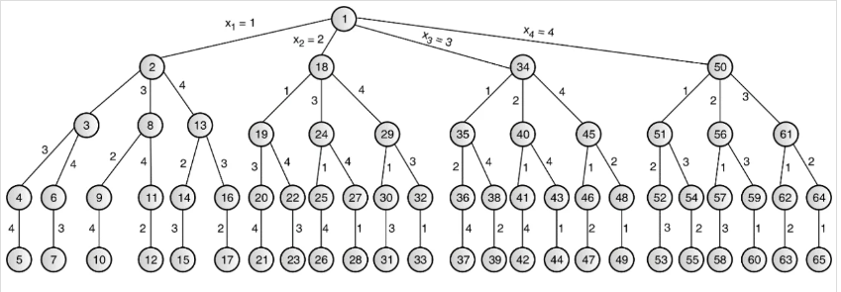
n-queen’s Problem
State space tree: It is a conceptual representation used in various fields such as search algorithms, optimization, and artificial intelligence to explore possible states (or configurations) of a problem. Each node in the tree represents a specific state, and the edges between nodes represent transitions between states.
State space tree for 4-Queen Problem:

Slide 14
Job sequencing with deadlines
Job sequencing with deadlines is a problem that involves scheduling a set of jobs to maximize profit while adhering to their respective deadlines. This approach assumes that each job can be completed in exactly one unit of time. If jobs have different durations, a more advanced scheduling algorithm might be necessary. Also, if the deadlines are represented as relative time (e.g., time units after job release), the algorithm would require adjustments accordingly.
Example :
Given the jobs, their deadlines and associated profits as shown-
Jobs | J1 | J2 | J3 | J4 | J5
Profit | 20 | 15 | 10 | 5 | 1
Deadline | 2 | 2 | 1 | 3 | 3

Slide 15
Job sequencing with deadlines
Solution:
0 1 2 3
Total Profit = J1+J2+J4
= 20+15+5
= 40
J1 | J2 | J4

Slide 16
Job sequencing with deadlines
Algorithm:
Sort the jobs: Sort the jobs based on their deadlines.
Create a result array: Create an array result of size n, where n is the number of jobs. Initialize all elements to -1.
Create a profit array: Create an array profit of size n, where n is the number of jobs. (he result array will store the sequence of jobs that maximizes the total profit.)
Iterate through the sorted jobs: Iterate through the sorted jobs. For each job:
Find the latest possible time slot in the result array where the job can be placed.
If such a time slot is found, place the job in that time slot and update the profit array.
Return the result: Return the result array, which contains the sequence of jobs that maximizes the total profit while meeting the deadlines.
Time Complexity: O(N log N)
Notes:
import java.util.*;
// A class to represent a job
class Job {
char id; // Job Id
int dead; // Deadline of job
int profit; // Profit earned if job is completed before
// deadline
public Job(char id, int dead, int profit)
{
this.id = id;
this.dead = dead;
this.profit = profit;
}
}
class JobProfit implements Comparator<Job> {
// Custom comparator to sort jobs by profit in
// descending order
public int compare(Job a, Job b)
{
return b.profit - a.profit;
}
}
public class JobScheduling {
public static void printJobScheduling(Job[] arr, int n)
{
// Result array to store selected jobs
List<Job> result = new ArrayList<>();
// Sort jobs by deadline in ascending order
Arrays.sort(arr, (a, b) -> a.dead - b.dead);
// Priority queue to select jobs with maximum profit
PriorityQueue<Job> pq
= new PriorityQueue<>(new JobProfit());
for (int i = n - 1; i >= 0; i--) {
int slot_available;
// Count available slots between two jobs
if (i == 0) {
slot_available = arr[i].dead;
}
else {
slot_available
= arr[i].dead - arr[i - 1].dead;
}
// Push job with the higher profit if two jobs
// have the same deadline
if (i > 0 && arr[i].dead == arr[i - 1].dead) {
if (arr[i].profit > arr[i - 1].profit) {
pq.add(arr[i]);
}
}
else {
pq.add(arr[i]);
}
// Select jobs as long as there are available
// slots
while (slot_available > 0 && !pq.isEmpty()) {
Job job = pq.poll();
slot_available--;
result.add(job);
}
}
// Sort selected jobs by deadline for output
result.sort((a, b) -> a.dead - b.dead);
// Print selected job sequence
for (Job job : result) {
System.out.print(job.id + " ");
}
System.out.println();
}
public static void main(String[] args)
{
Job[] arr
= { new Job('a', 2, 100), new Job('b', 1, 19),
new Job('c', 2, 27), new Job('d', 1, 25),
new Job('e', 3, 15) };
System.out.println(
"Following is maximum profit sequence of jobs: ");
printJobScheduling(arr, arr.length);
}
}

Slide 17
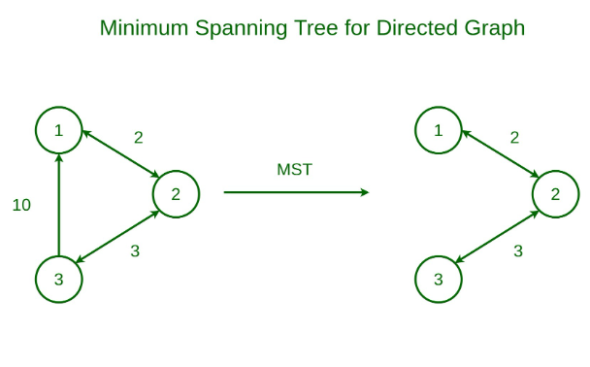
Minimum cost spanning trees
A spanning tree is defined as a tree-like subgraph of a connected, undirected graph that includes all the vertices of the graph.
The minimum spanning tree has all the properties of a spanning tree with an added constraint of having the minimum possible weights among all possible spanning trees. Like a spanning tree, there can also be many possible MSTs for a graph.

Slide 18
Minimum cost spanning trees
Properties of a Spanning Tree:
The number of vertices (V) in the graph and the spanning tree is the same.
There is a fixed number of edges in the spanning tree which is equal to one less than the total number of vertices ( E = V-1 ).
The spanning tree should not be disconnected, as in there should only be a single source of component, not more than that.
The spanning tree should be acyclic, which means there would not be any cycle in the tree.
The total cost (or weight) of the spanning tree is defined as the sum of the edge weights of all the edges of the spanning tree.
There can be many possible spanning trees for a graph.

Slide 19
Kruskal’s Minimum Spanning Tree (MST)
Kruskal's minimal spanning tree algorithm is one of the efficient methods to find the minimum spanning tree of a graph. A minimum spanning tree is a subgraph that connects all the vertices present in the main graph with the least possible edges and minimum cost (sum of the weights assigned to each edge).
Kruskal's Algorithm:
The inputs taken by the kruskal’s algorithm are the graph G {V, E}, where V is the set of vertices and E is the set of edges, and the source vertex S and the minimum spanning tree of graph G is obtained as an output.
Sort all the edges in non-decreasing order of their weight.
Pick the smallest edge. Check if it forms a cycle with the spanning tree formed so far. If the cycle is not formed, include this edge. Else, discard it.
Repeat step#2 until there are (V-1) edges in the spanning tree.

Slide 20
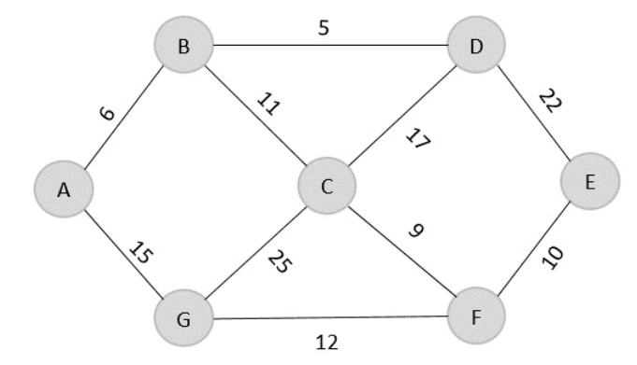
Kruskal’s Minimum Spanning Tree (MST)
Construct a minimum spanning tree using kruskal’s algorithm for the graph given below.
Solution:
Edge | B→D | A→B | C→F | F→E | B→C | G→F | A→G | C→D | D→E | C→G
Cost | 5 | 6 | 9 | 10 | 11 | 12 | 15 | 17 | 22 | 25

Slide 21
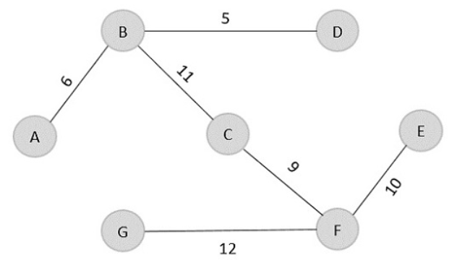
Kruskal’s Minimum Spanning Tree (MST)
Minimum cost = 5 + 6 + 9 + 10 + 11 + 12 = 53
Visited array, v = {B, D, A, C, F, E, G}
The obtained result is the minimum spanning tree of the given graph with cost = 53.

Slide 22
Kruskal’s Minimum Spanning Tree (MST)
Time Complexity: O(E * logE) or O(E * logV)
Sorting of edges takes O(E * logE) time.
After sorting, we iterate through all edges and apply the find-union algorithm. The find and union operations can take at most O(logV) time.
So overall complexity is O(E * logE + E * logV) time.
The value of E can be at most O(V²), so O(logV) and O(logE) are the same. Therefore, the overall time complexity is O(E * logE) or O(E*logV)

Slide 23
Prim’s Minimum Spanning Tree (MST)
Prim’s algorithm is a Greedy algorithm like Kruskal’s algorithm. This algorithm always starts with a single node and moves through several adjacent nodes, in order to explore all of the connected edges along the way.
Algorithm:
Step 1: Determine an arbitrary vertex as the starting vertex of the MST. Step 2: Follow steps 3 to 5 till there are vertices that are not included in the MST (known as fringe vertex). Step 3: Find edges connecting any tree vertex with the fringe vertices. Step 4: Find the minimum among these edges. Step 5: Add the chosen edge to the MST if it does not form any cycle. Step 6: Return the MST and exit
Notes:
public class prims {
static int inf = 999999;
static int MAX = 10;
static int G[][] = {
{0, 19, 8},
{21, 0, 13},
{15, 18, 0}
};
static int S[][] = new int[MAX][MAX];
static int n;
public static void main(String args[]) {
int i, j, cost;
n = 3;
cost=prims();
System.out.print("Spanning tree: ");
for(i=0; i<n; i++) {
System.out.println();
for(j=0; j<n; j++)
System.out.print(S[i][j] + " ");
}
System.out.println("\nMinimum cost = " + cost);
}
static int prims() {
int C[][] = new int[MAX][MAX];
int u, v = 0, min_dist;
int dist[] = new int[MAX];
int from[] = new int[MAX];
int visited[] = new int[MAX];
int ne,i,min_cost,j;
//create cost matrix and spanning tree
for(i=0; i<n; i++)
for(j=0; j<n; j++) {
if(G[i][j]==0)
C[i][j]=inf;
else
C[i][j]=G[i][j];
S[i][j]=0;
}
//initialise visited[],distance[] and from[]
dist[0]=0;
visited[0]=1;
for(i=1; i<n; i++) {
dist[i] = C[0][i];
from[i] = 0;
visited[i] = 0;
}
min_cost = 0; //cost of spanning tree
ne = n-1; //no. of edges to be added
while(ne > 0) {
//find the vertex at minimum distance from the tree
min_dist = inf;
for(i=1; i<n; i++)
if(visited[i] == 0 && dist[i] < min_dist) {
v = i;
min_dist = dist[i];
}
u = from[v];
//insert the edge in spanning tree
S[u][v] = dist[v];
S[v][u] = dist[v];
ne--;
visited[v]=1;
//updated the distance[] array
for(i=1; i<n; i++)
if(visited[i] == 0 && C[i][v] < dist[i]) {
dist[i] = C[i][v];
from[i] = v;
}
min_cost = min_cost + C[u][v];
}
return(min_cost);
}
}

Slide 24
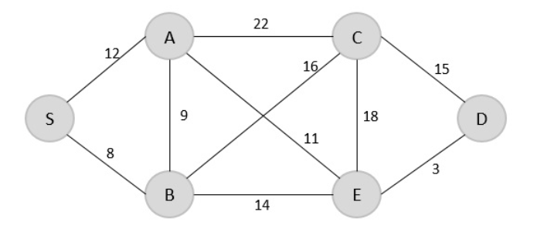
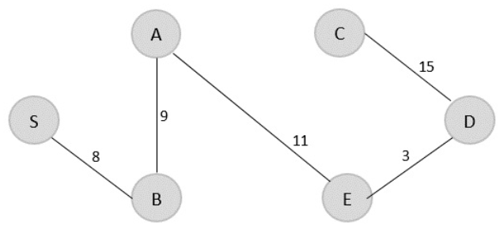
Find the minimum spanning tree using prim’s method (greedy approach) for the graph given below with S as the arbitrary root.
V = {S, B, A, E, D, C}
The minimum spanning tree is obtained with the
minimum cost = 46
Time Complexity: O(V²)

Slide 25
Single source shortest path problem
The Single Source Shortest Path (SSSP) problem is a classic problem in graph theory, It involves finding the shortest paths from a given source vertex to all other vertices in a weighted graph. The goal is to minimize the sum of the weights of the edges that make up the path.
Dijkstra’s Algorithm :
This algorithm is ideal for graphs with non-negative weights. It works by gradually building up the shortest path tree, starting from the source vertex and expanding outwards. It uses a priority queue to keep track of the vertices with the smallest tentative distances.

Slide 26
Dijkstra’s Algorithm
Declare two arrays − distance[] to store the distances from the source vertex to the other vertices in graph and visited[] to store the visited vertices.
Set distance[S] to ‘0’ and distance[v] = ∞, where v represents all the other vertices in the graph.
Add S to the visited[] array and find the adjacent vertices of S with the minimum distance.
The adjacent vertex to S, say A, has the minimum distance and is not in the visited array yet. A is picked and added to the visited array and the distance of A is changed from ∞ to the assigned distance of A, say d₁, where d₁ < ∞.
Repeat the process for the adjacent vertices of the visited vertices until the shortest path spanning tree is formed.
Notes:
public class Main {
static int min_dist(int dist[], boolean visited[]) { // finding minimum dist
int minimum = Integer.MAX_VALUE;
int ind = -1;
for (int k = 0; k < 6; k++) {
if (!visited[k] && dist[k] <= minimum) {
minimum = dist[k];
ind = k;
}
}
return ind;
}
static void greedy_dijkstra(int graph[][], int src) {
int dist[] = new int[6];
boolean visited[] = new boolean[6];
for (int k = 0; k < 6; k++) {
dist[k] = Integer.MAX_VALUE;
visited[k] = false;
}
dist[src] = 0; // Source vertex dist is set 0
for (int k = 0; k < 6; k++) {
int m = min_dist(dist, visited);
visited[m] = true;
for (int j = 0; j < 6; j++) {
// updating the dist of neighboring vertex
if (!visited[j] && graph[m][j] != 0 && dist[m] != Integer.MAX_VALUE
&& dist[m] + graph[m][j] < dist[j])
dist[j] = dist[m] + graph[m][j];
}
}
System.out.println("Vertex\t\tdist from source vertex");
for (int k = 0; k < 6; k++) {
char str = (char) (65 + k);
System.out.println(str + "\t\t\t" + dist[k]);
}
}
public static void main(String args[]) {
int graph[][] = { { 0, 1, 2, 0, 0, 0 }, { 1, 0, 0, 5, 1, 0 }, { 2, 0, 0, 2, 3, 0 },
{ 0, 5, 2, 0, 2, 2 }, { 0, 1, 3, 2, 0, 1 }, { 0, 0, 0, 2, 1, 0 } };
greedy_dijkstra(graph, 0);
}
}

Slide 27
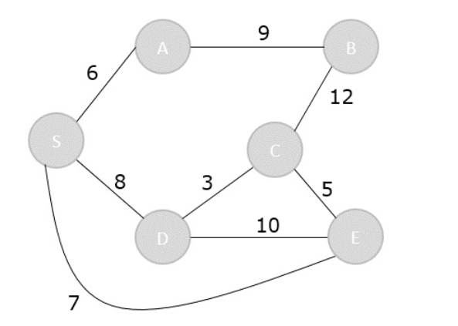
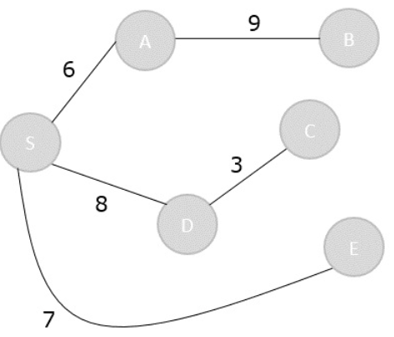
Dijkstra’s Algorithm
Analysis of the algorithm with the help of an example graph
The shortest path spanning tree is obtained as an output using the dijkstra’s algorithm.
Notes:
public class Main {
static int min_dist(int dist[], boolean visited[]) { // finding minimum dist
int minimum = Integer.MAX_VALUE;
int ind = -1;
for (int k = 0; k < 6; k++) {
if (!visited[k] && dist[k] <= minimum) {
minimum = dist[k];
ind = k;
}
}
return ind;
}
static void greedy_dijkstra(int graph[][], int src) {
int dist[] = new int[6];
boolean visited[] = new boolean[6];
for (int k = 0; k < 6; k++) {
dist[k] = Integer.MAX_VALUE;
visited[k] = false;
}
dist[src] = 0; // Source vertex dist is set 0
for (int k = 0; k < 6; k++) {
int m = min_dist(dist, visited);
visited[m] = true;
for (int j = 0; j < 6; j++) {
// updating the dist of neighboring vertex
if (!visited[j] && graph[m][j] != 0 && dist[m] != Integer.MAX_VALUE
&& dist[m] + graph[m][j] < dist[j])
dist[j] = dist[m] + graph[m][j];
}
}
System.out.println("Vertex\t\tdist from source vertex");
for (int k = 0; k < 6; k++) {
char str = (char) (65 + k);
System.out.println(str + "\t\t\t" + dist[k]);
}
}
public static void main(String args[]) {
int graph[][] = { { 0, 1, 2, 0, 0, 0 }, { 1, 0, 0, 5, 1, 0 }, { 2, 0, 0, 2, 3, 0 },
{ 0, 5, 2, 0, 2, 2 }, { 0, 1, 3, 2, 0, 1 }, { 0, 0, 0, 2, 1, 0 } };
greedy_dijkstra(graph, 0);
}
}

Slide 28
Dijkstra’s Algorithm
Visited = {S, A, E, D, C, B}
Vertex(S) | A | B | C | D | E
Distance | ∞ | ∞ | ∞ | ∞ | ∞
 | 6 | ∞ | ∞ | 8 | 7
 | 6 | 15 | ∞ | 8 | 7
 | 6 | 15 | 12 | 8 | 7
 | 6 | 15 | 11 | 8 | 7

Slide 29
Time complexity of Dijkstra’s Algorithm:
The space complexity of the algorithm is O(V) for storing the distances and predecessors for each node, along with additional space for data structures like priority queues or arrays.
Case | Complexity
Best Case | O((V + E) log V)
Average Case | O((V + E) log V)
Worst Case | O((V²) log V)
Notes:
public class Main {
static int min_dist(int dist[], boolean visited[]) { // finding minimum dist
int minimum = Integer.MAX_VALUE;
int ind = -1;
for (int k = 0; k < 6; k++) {
if (!visited[k] && dist[k] <= minimum) {
minimum = dist[k];
ind = k;
}
}
return ind;
}
static void greedy_dijkstra(int graph[][], int src) {
int dist[] = new int[6];
boolean visited[] = new boolean[6];
for (int k = 0; k < 6; k++) {
dist[k] = Integer.MAX_VALUE;
visited[k] = false;
}
dist[src] = 0; // Source vertex dist is set 0
for (int k = 0; k < 6; k++) {
int m = min_dist(dist, visited);
visited[m] = true;
for (int j = 0; j < 6; j++) {
// updating the dist of neighboring vertex
if (!visited[j] && graph[m][j] != 0 && dist[m] != Integer.MAX_VALUE
&& dist[m] + graph[m][j] < dist[j])
dist[j] = dist[m] + graph[m][j];
}
}
System.out.println("Vertex\t\tdist from source vertex");
for (int k = 0; k < 6; k++) {
char str = (char) (65 + k);
System.out.println(str + "\t\t\t" + dist[k]);
}
}
public static void main(String args[]) {
int graph[][] = { { 0, 1, 2, 0, 0, 0 }, { 1, 0, 0, 5, 1, 0 }, { 2, 0, 0, 2, 3, 0 },
{ 0, 5, 2, 0, 2, 2 }, { 0, 1, 3, 2, 0, 1 }, { 0, 0, 0, 2, 1, 0 } };
greedy_dijkstra(graph, 0);
}
}

